Slide 1
Series of Paragraphs
Expressing an opinion on a given topic using a series of paragraphs

Slide 2
Examples
Here are some examples of student work and grades from the 2010 – 2011 OSSLT.
Review the annotation notes at the bottom of each example.

Slide 3
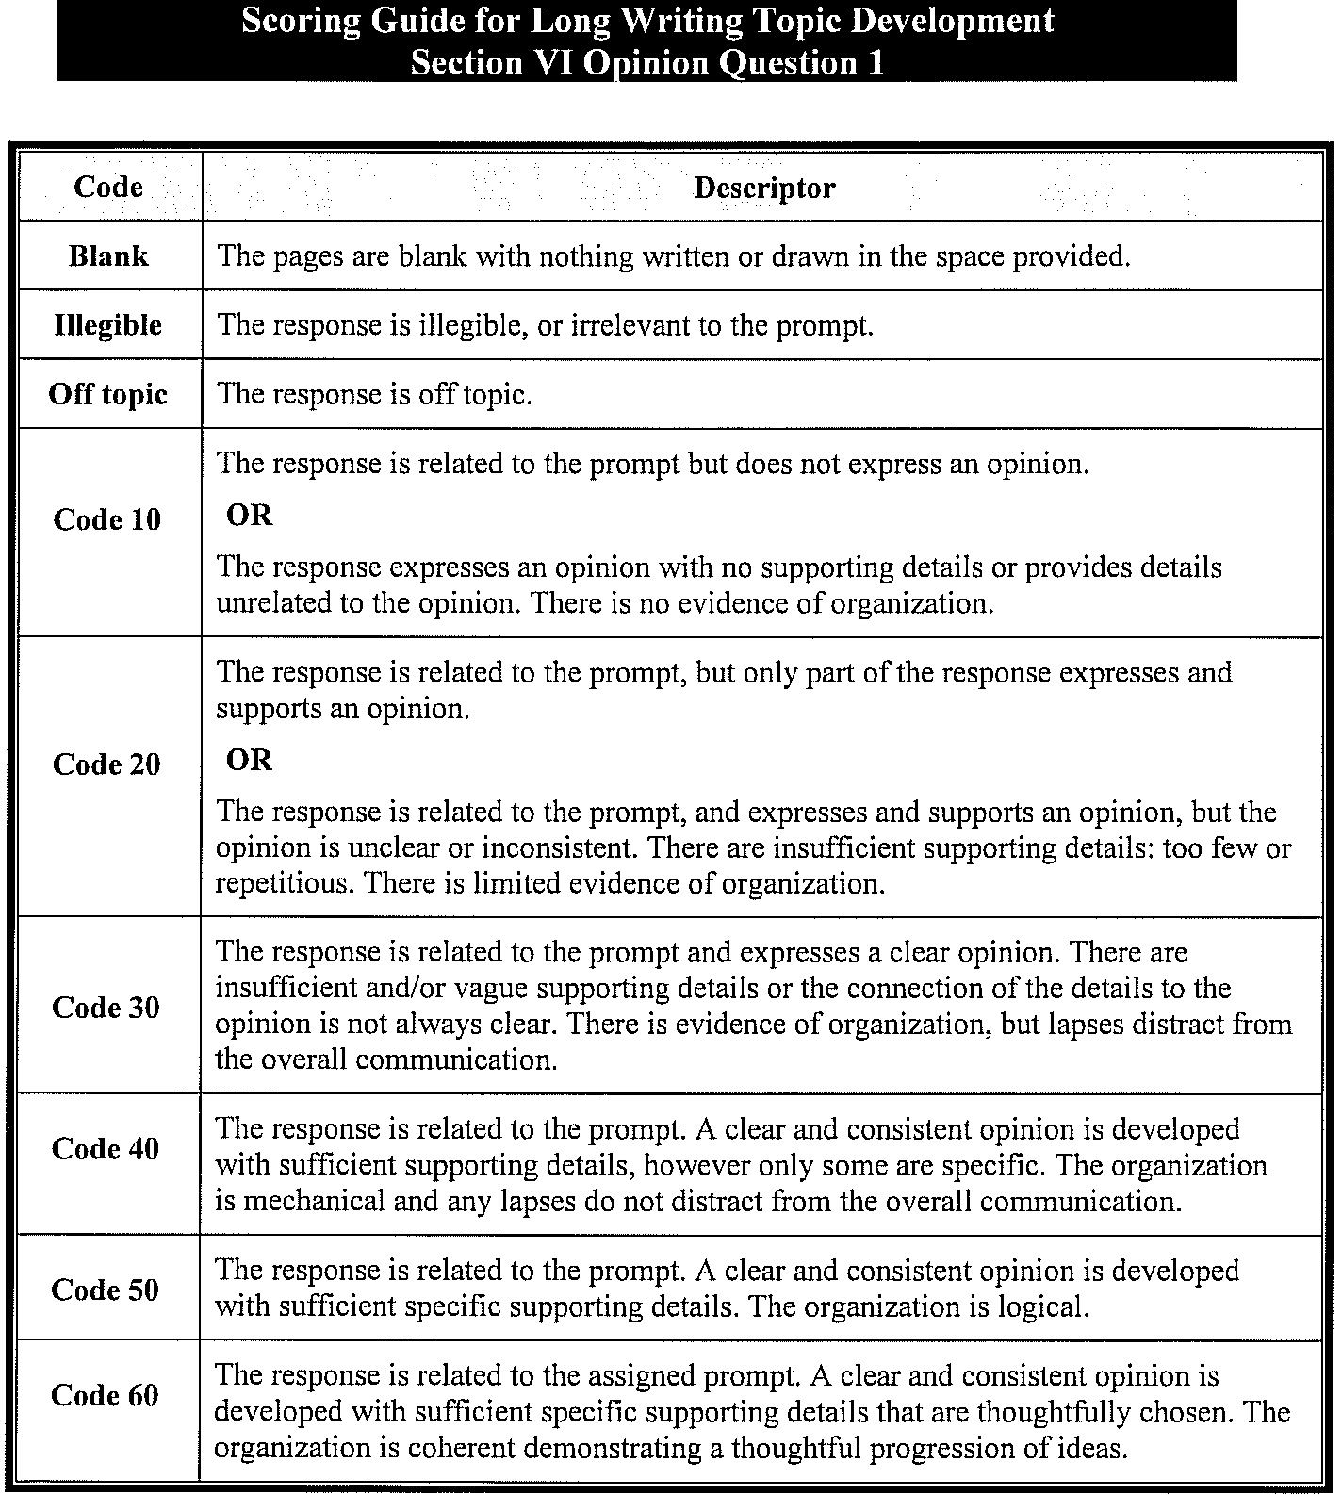

Slide 4
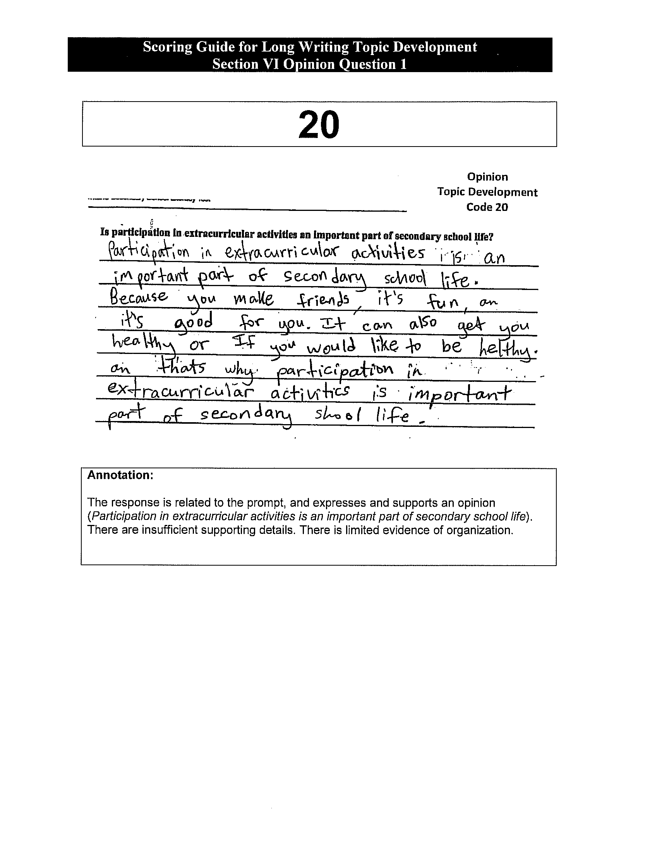
Poor Answer

Slide 5
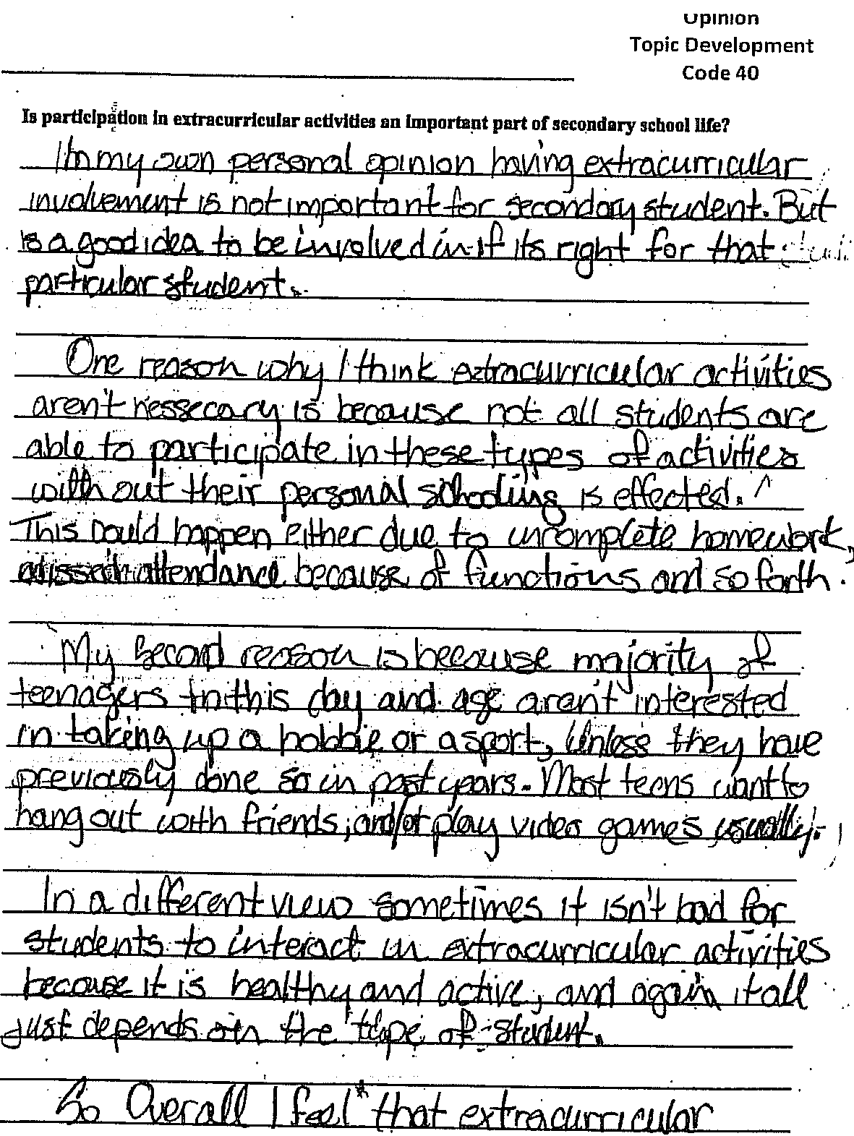
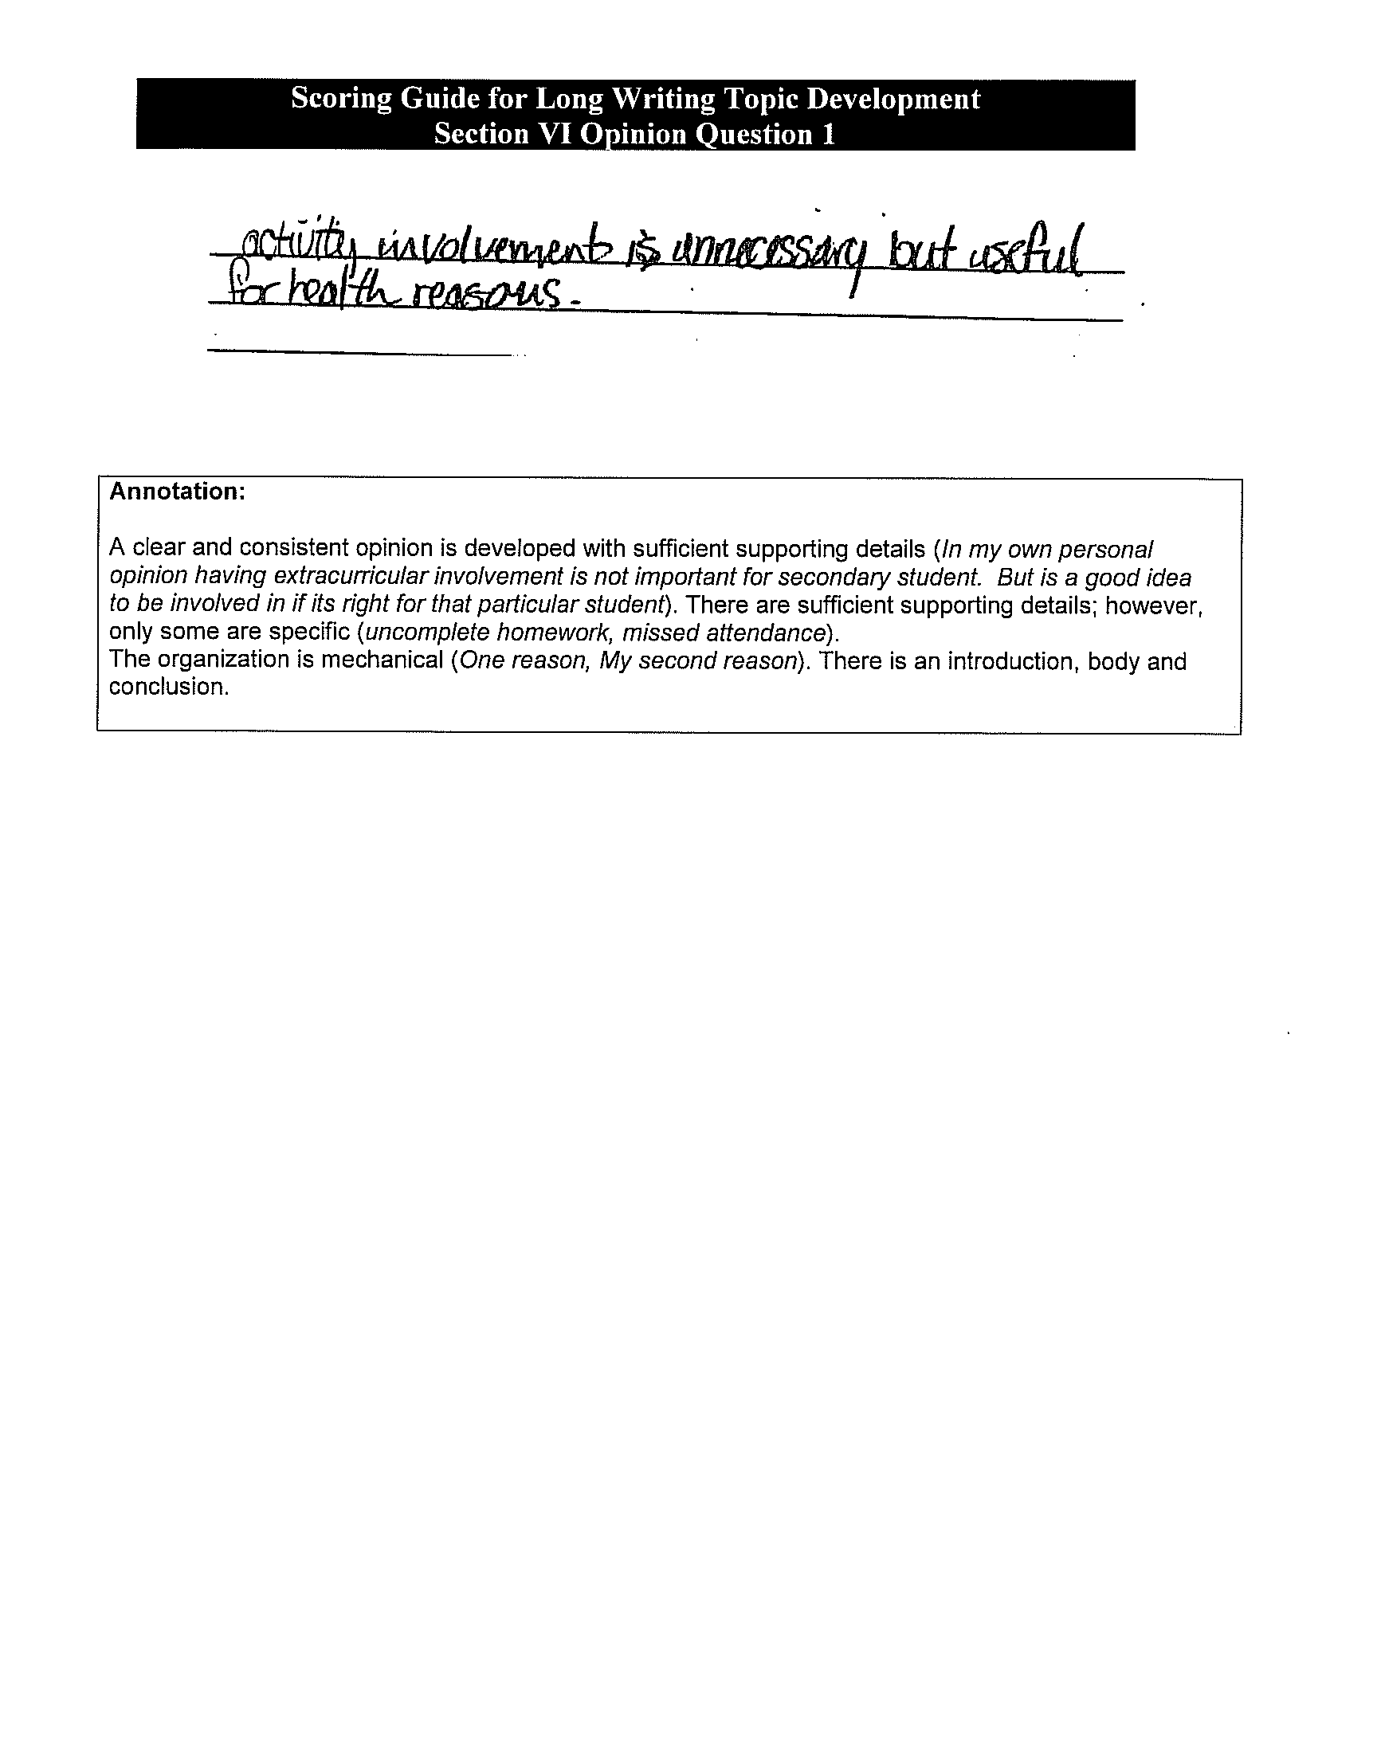
Better Answer

Slide 6
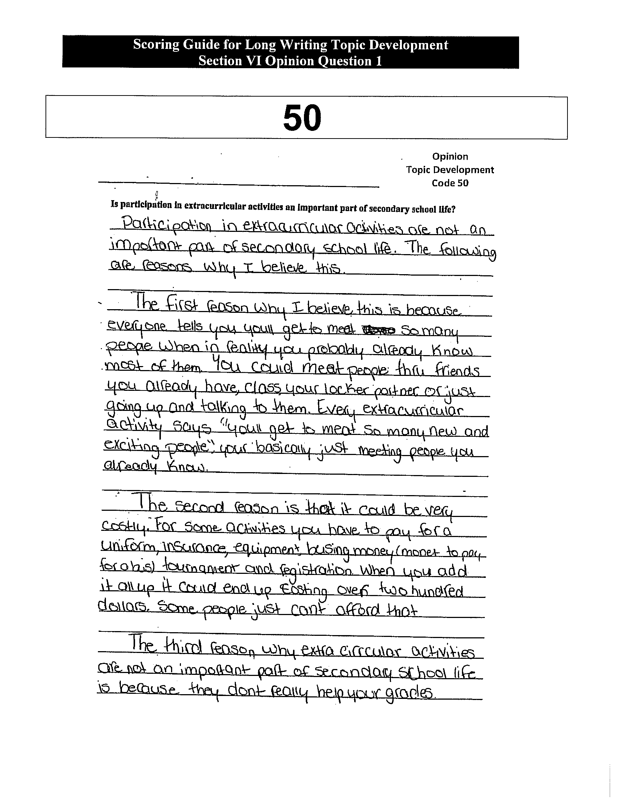
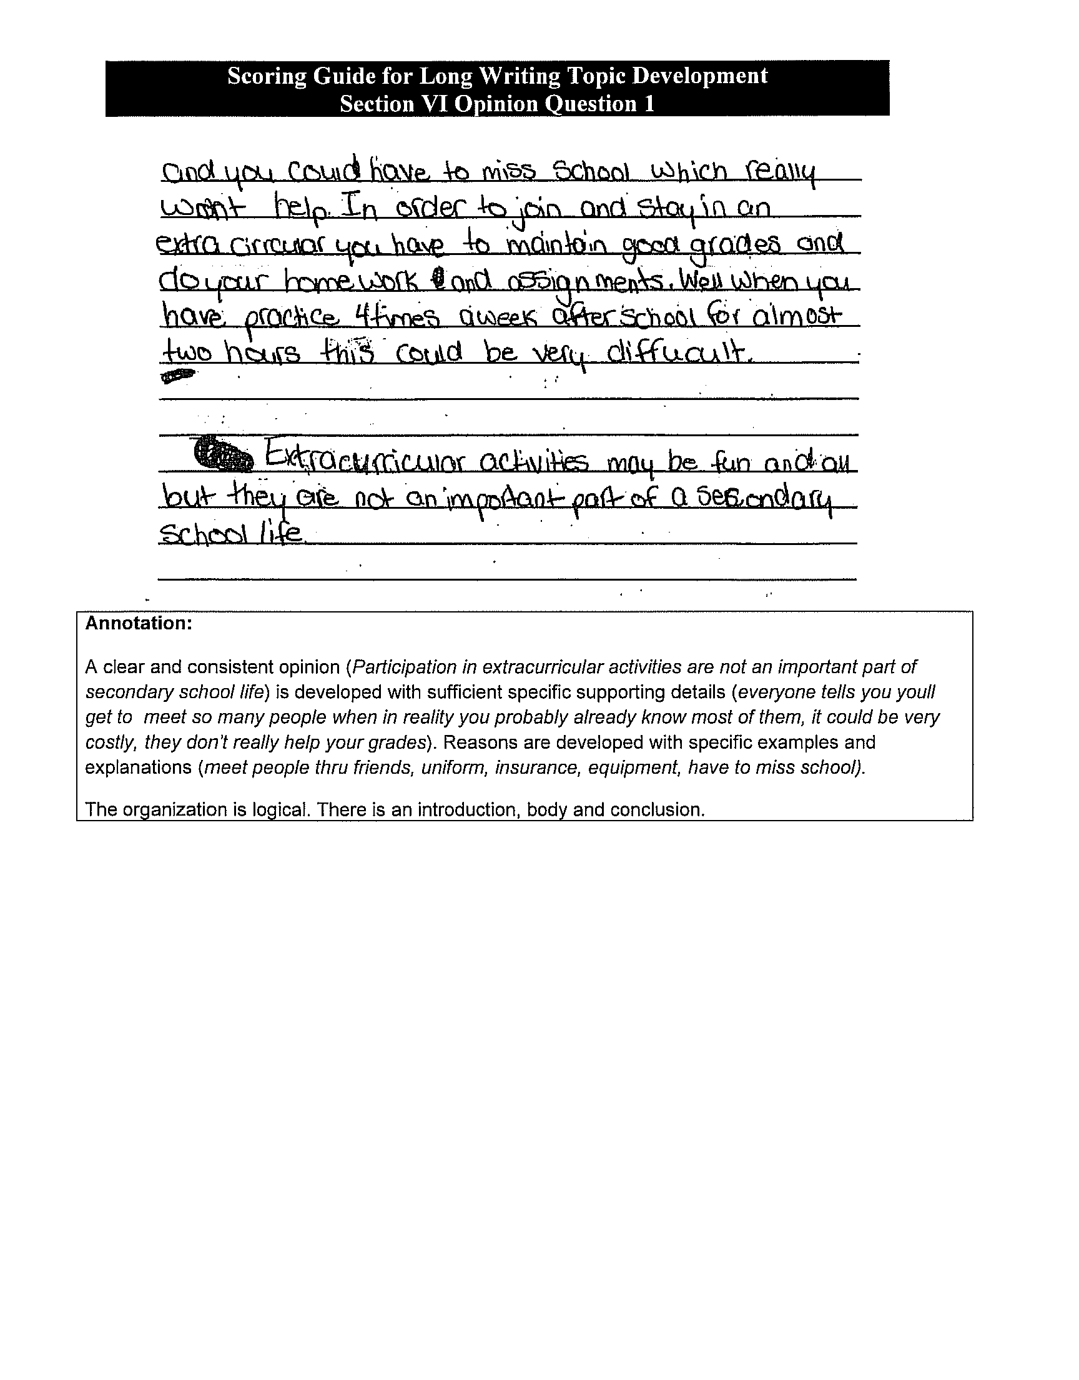
Even Better Answer

Slide 7
Key Tips to Passing the Opinion Essay

Slide 8
Class Activity
Here is a pretty good example of an opinion essay.
Read it together as a class.
Work through the questions together as a group. Use the interactive pen to record answers.
Try completing the class opinion piece together.

Slide 9
Opinion Piece: Should Dogs Be Banned From Public Parks?
Dogs are an important part of our world. They are good friends who encourage us. They should be allowed in public parks for economic, emotional and health reasons. If they are banned from parks, where would they go?
If dogs were banned from public parks, there would be huge losses in the economy. With nowhere to take dogs, who would want to buy them? Many pet stores and dog breeders would go bankrupt, and this could cause many people to be out of work. Our economy is already bad, and banning dogs from parks would make the economy even worse. The effects would be felt for a long time.
Dogs are known as “man’s best friend,” and if you can’t take your best friend to the park, many people would be upset. It is well known that dogs help make people feel better when they are sad or depressed. Dogs accept you no matter what. They don’t care how much you weigh or what kind of clothes you wear. They still wag their tails for you when you come home and are happy to see you. Banning dogs from parks will upset people and take away the positive, happy emotions a dog can give you in the first place.
continued…

Slide 10
Opinion Piece: Should Dogs Be Banned From Public Parks?
continued…
The final reason not to ban dogs from public parks would be for health reasons. People get more exercise when they have to walk a dog. Putting limits on where you can walk a dog might also limit how much walking people do. They might just let their dog out in their back yard, and then they wouldn’t be getting the exercise they need. Also, many people take their dog to the park along with their kids so if you can’t take your dog to the park, you might decide not to take your kids to the park. Kids are gaining more and more weight these days, and we need to encourage them to go to parks and play to get exercise and be healthy and not to stay away from parks. Banning dogs from parks would not help improve people’s health.
Overall, I am against banning dogs in public parks. I think it is not good for the economy, for our emotional side and for our health. Instead we should encourage people and dogs to use our parks. Just make sure you take a bag with you to clean up after your dog!

Slide 11
Opinion Piece: Questions
What are the three main reasons for banning dogs?
Reason 1 –
Reason 2 –
Reason 3 –
What examples are given to support each reason?
Paragraph 1 –
Paragraph 2 –
Paragraph 3 –
continued…

Slide 12
Opinion Piece: Questions
continued…
Where were connecting words and transitions
used in the paragraph?
(examples: also, first, next, etc.)
Where could you add connecting words or
transitions in the essay?

Slide 13
Opinion Piece: Class Activity
Write an opinion piece expressing the opposite side i.e. arguing that dogs should be banned
continued…
Second Supporting Paragraph
Second reason supporting your opinion: ______________________________
examples to support this reason: ___________________________________
___________________________________
___________________________________
Third Supporting Paragraph
Third reason supporting your opinion: ________________________________
examples to support this reason: ___________________________________
___________________________________
___________________________________

Slide 14
Opinion Piece: Class Activity
Write an opinion piece expressing the opposite side i.e. arguing that dogs should be banned
continued…
Second Supporting Paragraph
Second reason supporting your opinion: ______________________________
examples to support this reason: ___________________________________
___________________________________
___________________________________
Third Supporting Paragraph
Third reason supporting your opinion: ________________________________
examples to support this reason: ___________________________________
___________________________________
___________________________________

Slide 15
Opinion Piece: Class Activity
Write an opinion piece expressing the opposite side i.e. arguing that dogs should be banned
continued…
Concluding Paragraph
Restate Your Opinion: _______________________________________
Restate 3 Main Reasons Supporting Your Opinion: ______________________
______________________
______________________
General Ending Sentence: __________________________

Slide 16
Power point presentation is from St. Mary’s High School in Kitchener, Ontario http://stmary.wcdsb.ca/student_services/literacy_test_prep.html

