Slide 1
Subject-Specific Literacy Test Short Answer Examples

Slide 2
Table of Contents
Who Ate Pasta First?…………………………………………....slides 3 - 7
How an Eco-Friendly Fish Farm Operates................slides 8 - 10
Simon Jackson: Saving the Spirit Bear………….………slides 11 - 14
New Discoveries: Dinosaur Capital of the World ...slides 15 - 19
I’ll Be Your Server Tonight……………………………..……..slides 20 - 27
Writing, Grammar and Sentence Structure…..…….. slides 28 - 33

Slide 3
Who Ate Pasta First?

Slide 4
Who Ate Pasta First?

Slide 5
Who Ate Pasta First?

Slide 6
Who Ate Pasta First?

Slide 7
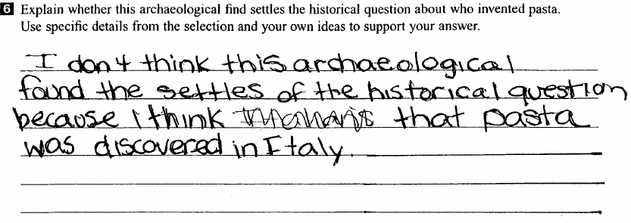
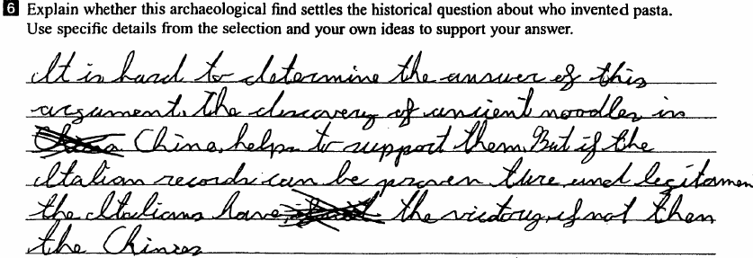
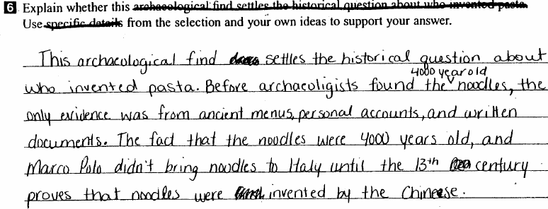
Who Ate Pasta First?
10 points
20 points
30 points

Slide 8
How an Eco-Friendly Fish Farm Operates

Slide 9
How an Eco-Friendly Fish Farm Operates

Slide 10
How an Eco-Friendly Fish Farm Operates

Slide 11
Simon Jackson: Saving the Spirit Bear
Continued…

Slide 12
Simon Jackson: Saving the Spirit Bear
Continued….

Slide 13
Simon Jackson: Saving the Spirit Bear

Slide 14
Simon Jackson: Saving the Spirit Bear
Answers

Slide 15
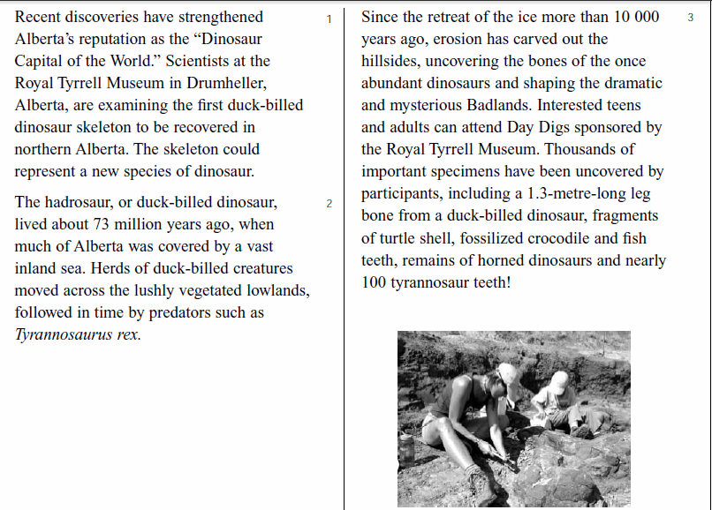
New Discoveries at the Dinosaur Capital of the World

Slide 16
New Discoveries at the Dinosaur Capital of the World

Slide 17
New Discoveries at the Dinosaur Capital of the World

Slide 18
New Discoveries at the Dinosaur Capital of the World

Slide 19
New Discoveries at the Dinosaur Capital of the World
10 points
20 points
30 points

Slide 20
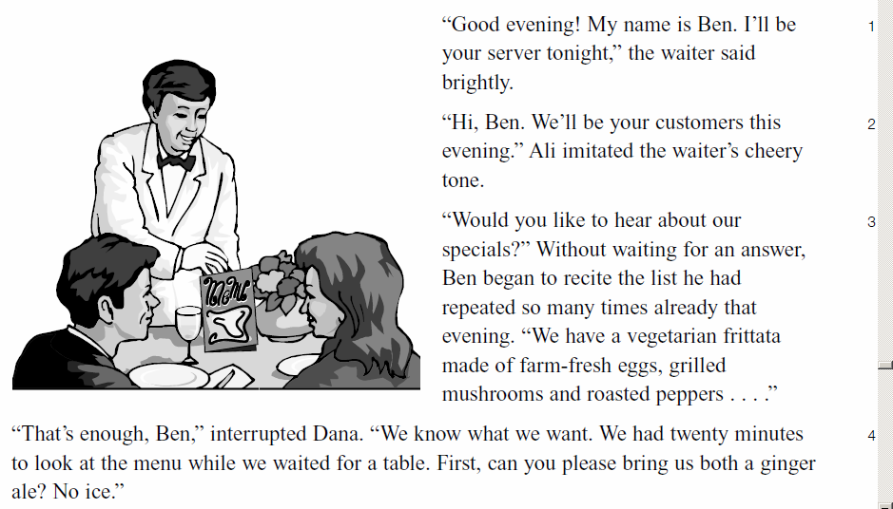
I’ll Be Your Server Tonight
Continued…

Slide 21
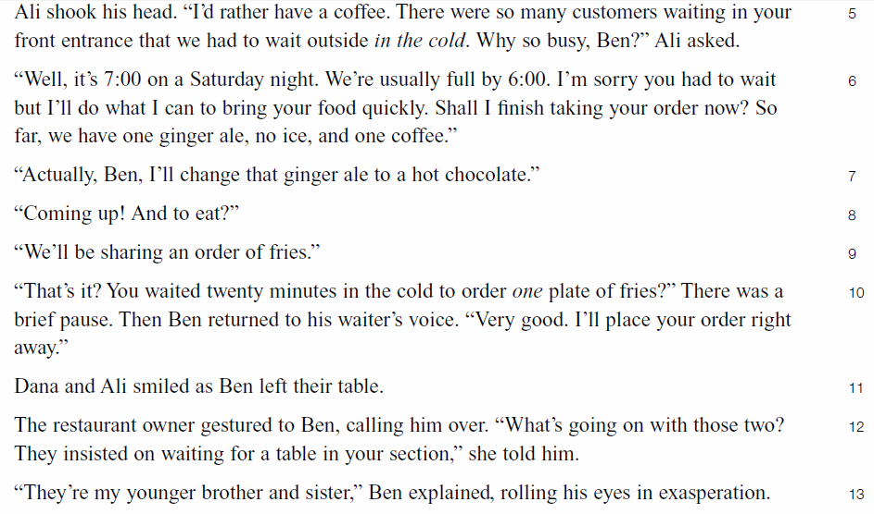
I’ll Be Your Server Tonight

Slide 22
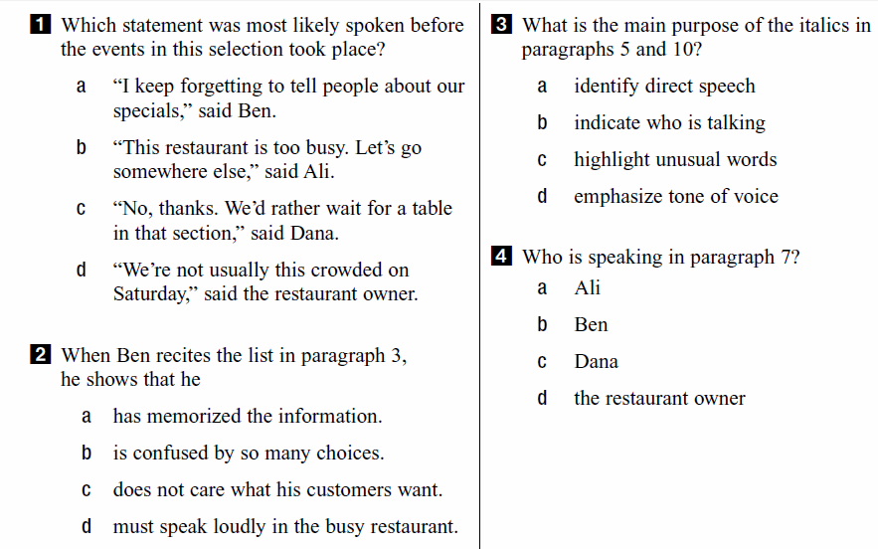
I’ll Be Your Server Tonight

Slide 23
I’ll Be Your Server Tonight

Slide 24
I’ll Be Your Server Tonight

Slide 25
I’ll Be Your Server Tonight
Code 10
Code 20
Code 30

Slide 26
I’ll Be Your Server Tonight

Slide 27
I’ll Be Your Server Tonight
Code 10
Code 20
Code 30

Slide 28
Writing, Grammar and Sentence Structure

Slide 29
Grammar Answers

Slide 30
Writing, Grammar and Sentence Structure

Slide 31
Grammar Answers

Slide 32
Writing, Grammar and Sentence Structure

Slide 33
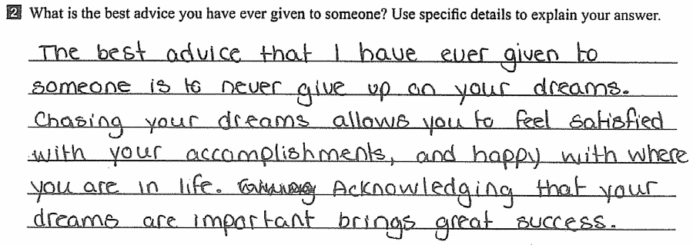
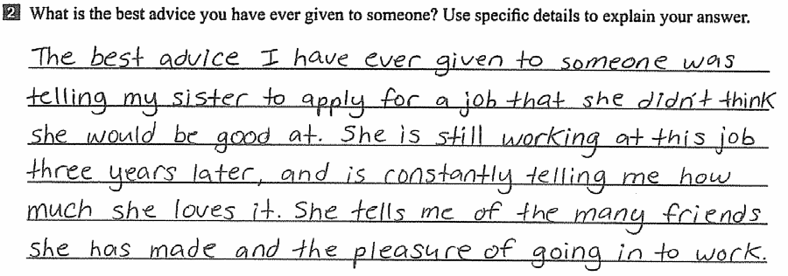
Writing, Grammar and Sentence Structure Answers
10 points
20 points
30 points

Slide 34
Power point presentation is from St. Mary’s High School in Kitchener, Ontario http://stmary.wcdsb.ca/student_services/literacy_test_prep.html

